Slide 1
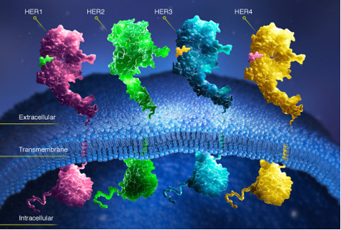
Silencing of the HER2 Gene by siRNA Inhibits Proliferation and Induces Apoptosis in HER2–Overexpressing Breast Cancer Cells
Timo Faltus, Juping Yuan, Brigitte Zimmer, Andrea Kra¨mer, Sibylle Loibl, Manfred Kaufmann and Klaus Strebhardt
https://www.ncbi.nlm.nih.gov/pmc/articles/PMC1531682/pdf/neo0606_0786.pdf
PAULINE NARVAS

Slide 2
Introduction

Slide 3
Treatment with Herceptin

Slide 4
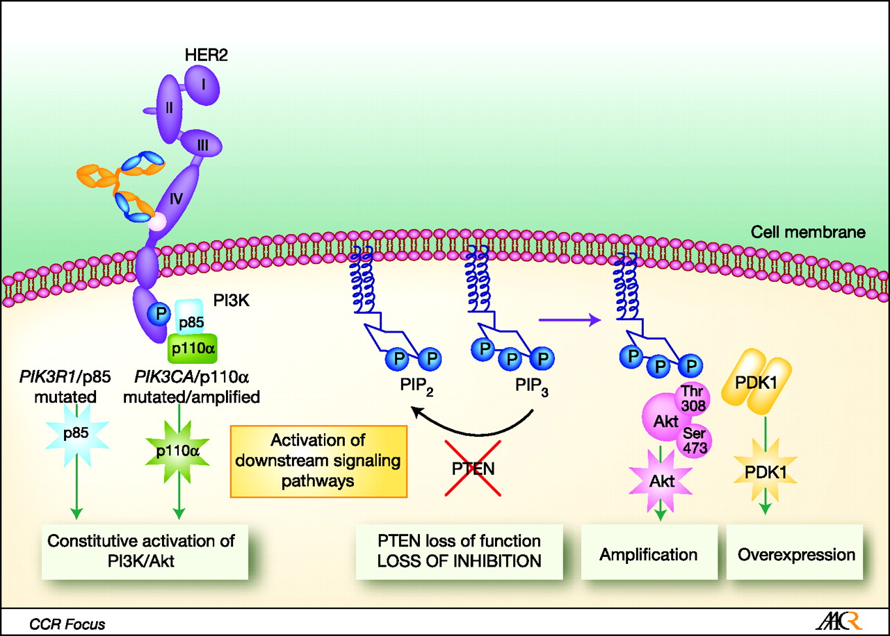
Problems with Herceptin

Slide 5
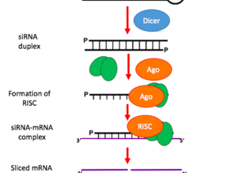

Materials
siRNA
Using a breast cancer cell line
In vitro transfection of siRNA - using the Oligofectamine protocol
Northern blot
Western blot

Slide 6
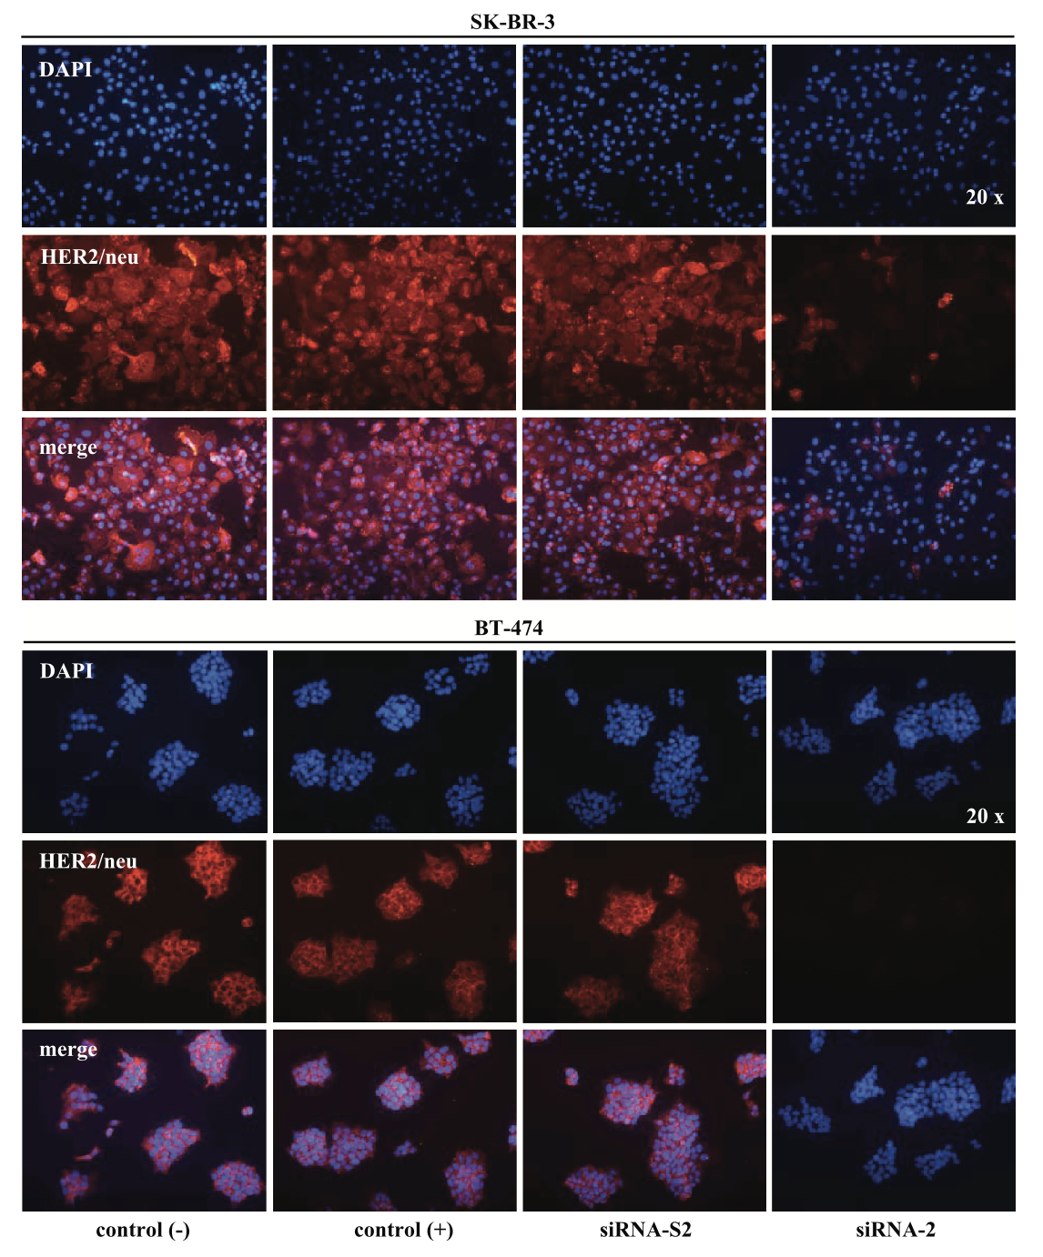
Results 1
Looked at cell proliferation in siRNA transfected cell lines.
siRNA transfection -| HER2 expression
siRNA found to have a anti-proliferative effect.
Notes:
Transfected the cell lines with siRNA
And found that after 96 hours, there was an inhibition of HER2 expression
With siRNA-3 being the strongest anti-proliferative effect.

Slide 7
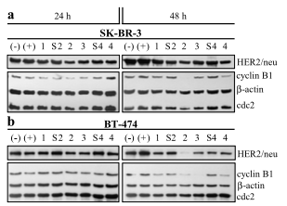
Results 2
Cell cycle of the cells treated with siRNA
Increase in proportion of cells in G0/G1 phase compared to control
Used western blot for markers of the later stages in cell cycle progression.
Found the marker was heavily downregulated in siRNA infected cells.

Slide 8
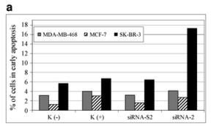
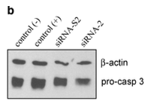
Results 3
Did the cells arrested in G0/G1 then progressed to apoptosis?
Stained with Annexin V and PI analysed the cells using flow cytometry.
Annexin V positive = yes, they did go into apoptosis!
Further study with procaspse-3 Western Blot
Notes:
Pro-casp3 is the precusor of the caspase (the enzymes that control apoptosis)
Reduced in siRNA transfected cells

Slide 9
Summary
siRNA can silence genes that code for HER2 receptors...
siRNA showed anti-proliferative effect
Can be used as an alternative to antibody-specific therapeutics like Herceptin.
Herceptin is cytostatic (inhibits) rather than cytotoxic unlike using siRNA.
siRNA is very specific.
But is still a very promising approach towards HER2 positive cancer treatment!
But… only has been done on hepatocytes.
And in vitro.
Notes:
Cytotoxic = What you’d want to target overexpressing HER2 positive cancer cells!

